Slide 1
Starting to Talk:
CUPE Climate Change Conversations
CUPE National Environment Committee
Notes:
Welcome!
This presentation is called “Starting to Talk: CUPE Climate Change Conversations”.
It was developed at CUPE national with input by CUPE’s national environment committee.

Slide 2
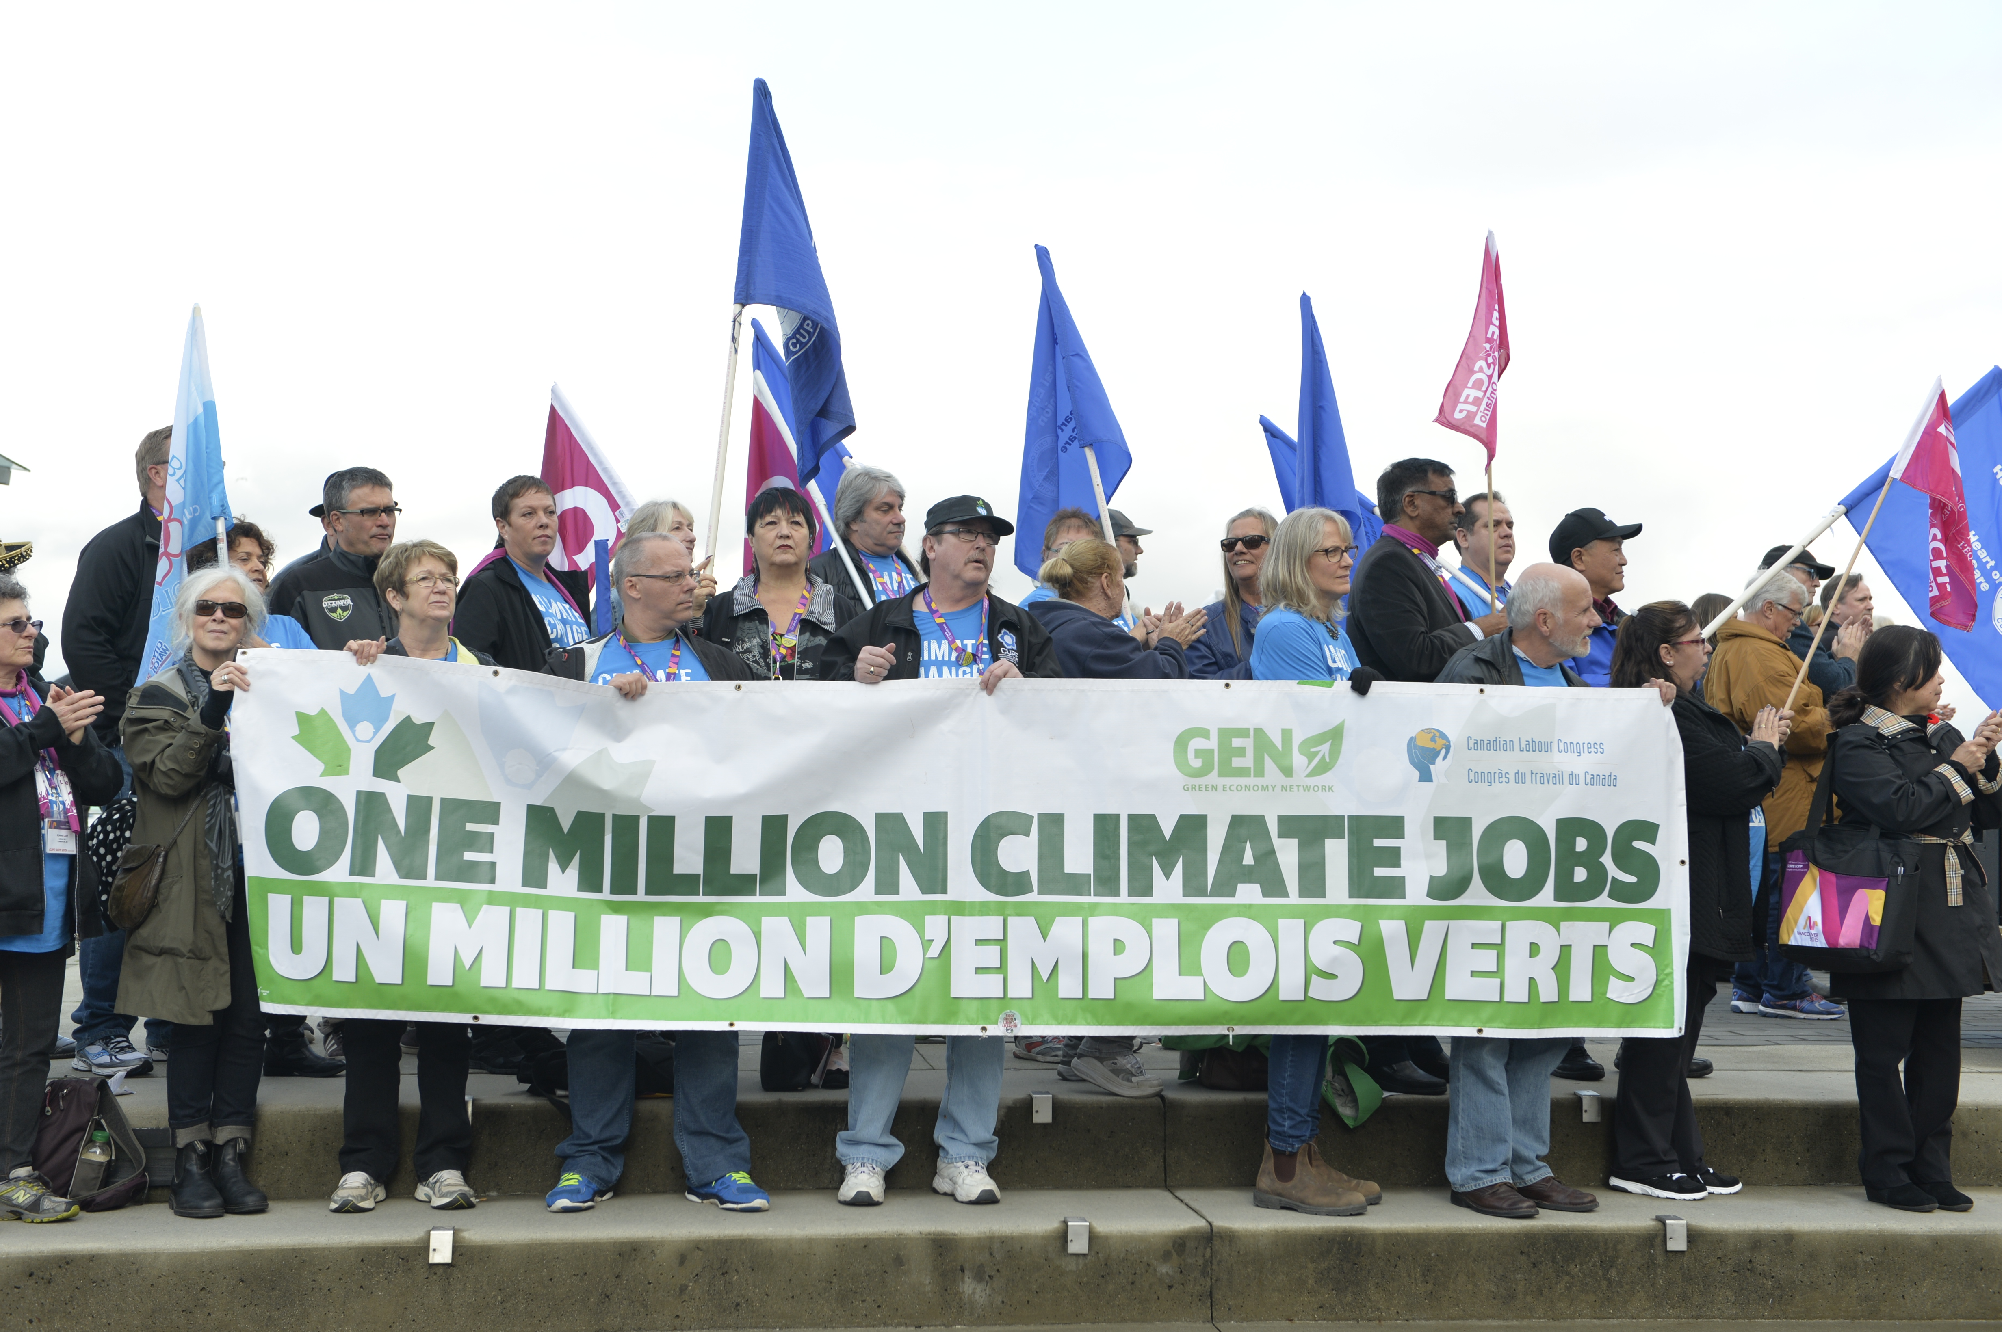
CUPE activists rally for climate jobs, November 2015.
Notes:
Activists
We’re here to talk about climate change, which is an issue that CUPE members care about.

Slide 3
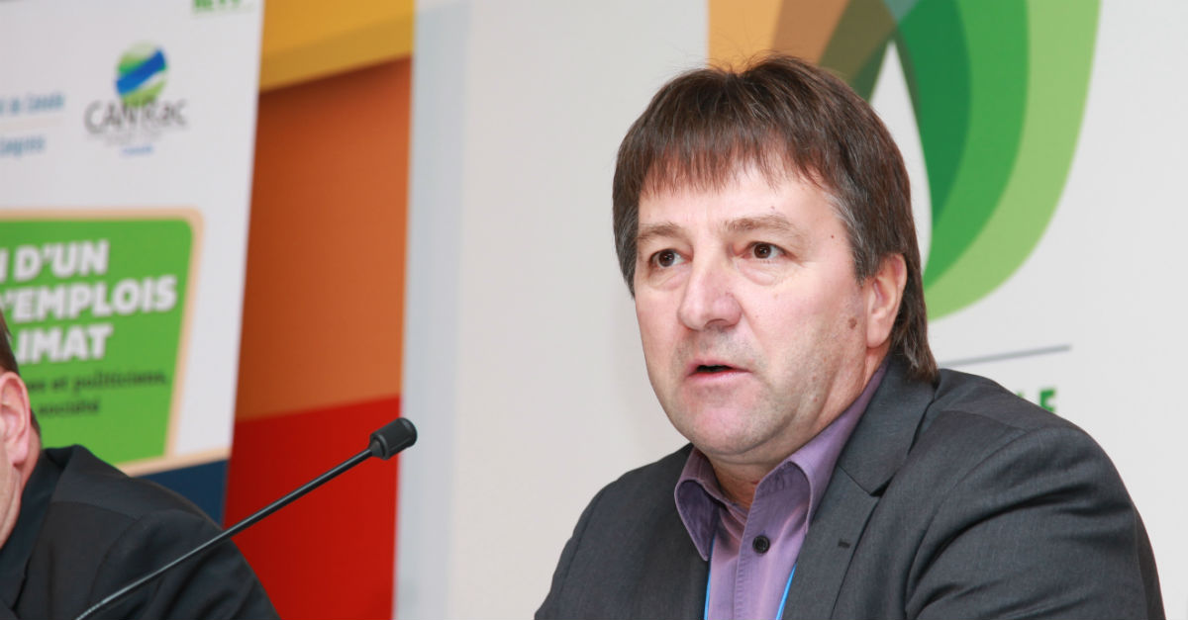
CUPE leadership on climate change: Charles Fleury at UN negotiations, December 2015.
Notes:
CUPE leadership
CUPE believes that the environment is a workers’ issue. CUPE leaders speak out often on climate change.
Here is Brother Charles Fleury in Paris at the United Nations Climate Summit promoting CUPE’s ideas.

Slide 4
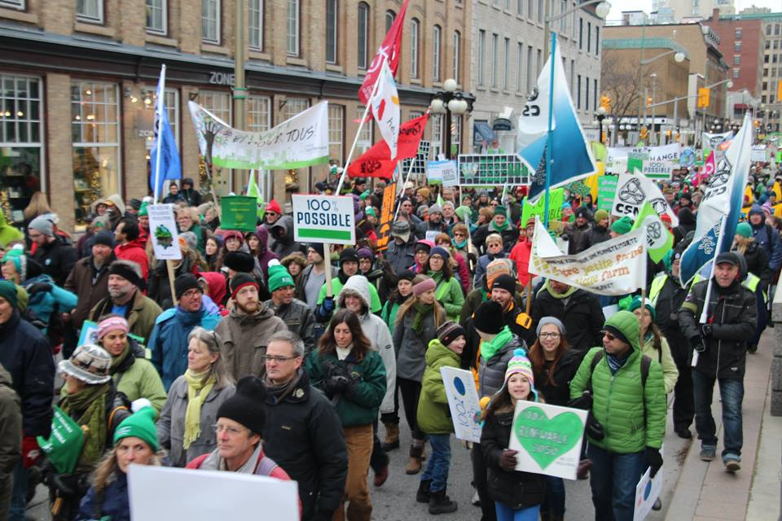
Labour and civil society march for climate justice in Ottawa, November 2015.
Notes:
March
CUPE and Labour also often join with the public, and other allies, to call for action to slow climate change.

Slide 5
Why are we talking about climate change?
Scientists agree that we need urgent action.
Unions must be leaders in the fight against climate change.
Notes:
Why?
Why are we talking about climate change?
Because it’s happening now. The science is clear that we need urgent action.
It is a critical social justice issue. Climate change affects jobs and communities. And unions need to work to find solutions to this problem.

Slide 6

And the first step is…
Learn about the issue.
Talk about climate change with other CUPE members.
Notes:
And the first step is
Where do we start? What are the first steps?
We need to learn and share ideas and experiences.
We need to talk openly about climate change.
(Here you (the presenter) can tell a quick story about what you think about when you think about climate change or give a personal story about how climate change affects you.)

Slide 7
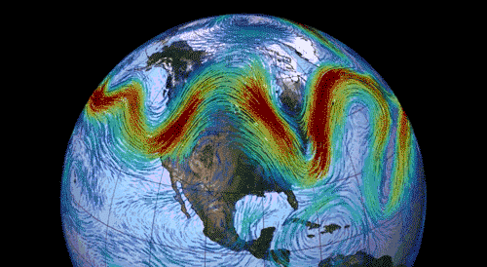
Climate change impacts:
More extreme weather
Notes:
More extreme weather
What are the biggest impacts of climate change?
While climate and weather are not the same thing, there is no denying that our weather patterns have changed and are getting unpredictable and whacky.
One reason this happens is because there is more heat energy in the atmosphere. One effect of this is that it can upset the Jetstream. The Jetstream is now often waiver and moves more slowly, making our weather more intense.

Slide 8
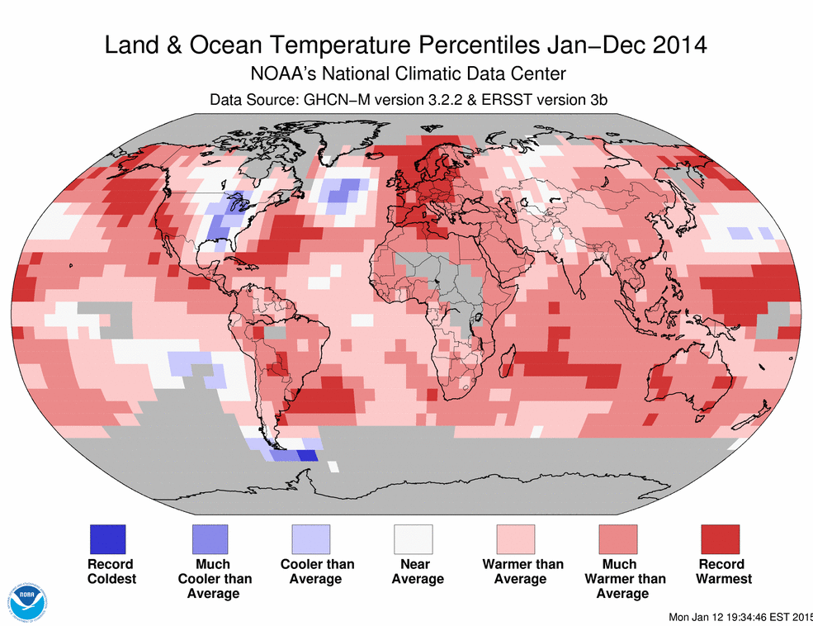
Colder in Canada in 2014 but warmer almost everywhere else
Notes:
Graphic of global temperatures for 2014
Let’s have a look at how global temperatures have changed.
Compared to historical averages, 2014 was above average in most of the world, as the red dots show.
Weirdly, Canada – especially central Canada – was one of the few areas where temperatures were below normal in 2014.
Europe shows lots of red. As does parts of China, Australia and the Pacific Coast off BC.
So, on average, the earth is getting warmer. But it is not getting warmer equally. Climate change doesn’t have the same impacts everywhere; it varies.

Slide 9
Hot!
2015 was the hottest year on record:
0.9ºC above 20th century average.
Five hottest years on record: 2015, 2014, 2010, 2013 and 2005.
Notes:
Hot!
It is impossible to deny the facts.
2015 was the hottest year on record, ever.
The five hottest years globally have all happened in the 21st century, since 2005 in fact.
2015 was 0.9 degrees celcius above the 20th century’s average.

Slide 10
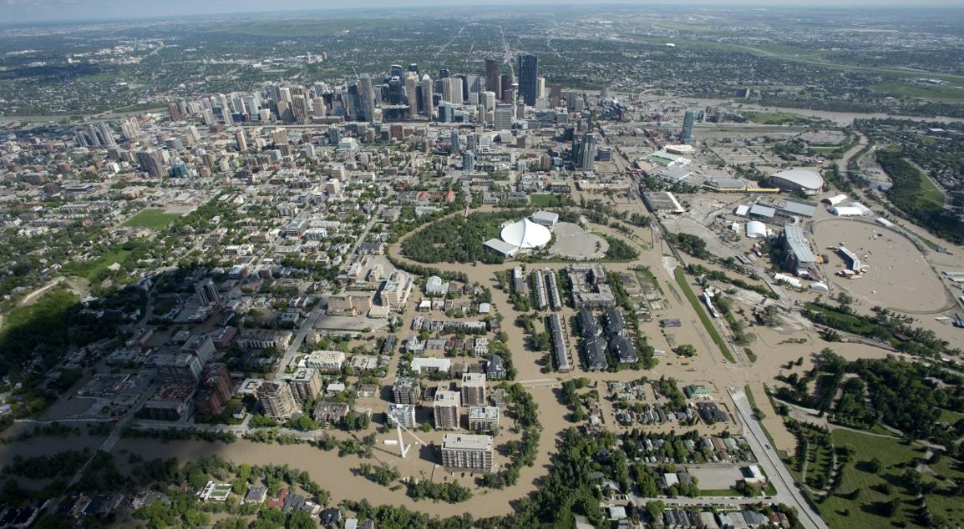
Calgary, June 22nd 2013
Notes:
Calgary in June 2013
This is what climate change looks like.
The Calgary flood, in 2013, was caused by rapid snow melt and heavy rain. It devastated Calgary and other parts of Alberta.
This event caused $1.7 billion in damages.
CUPE members were on the front lines responding to this situation and cleaning up after the flood.

Slide 11
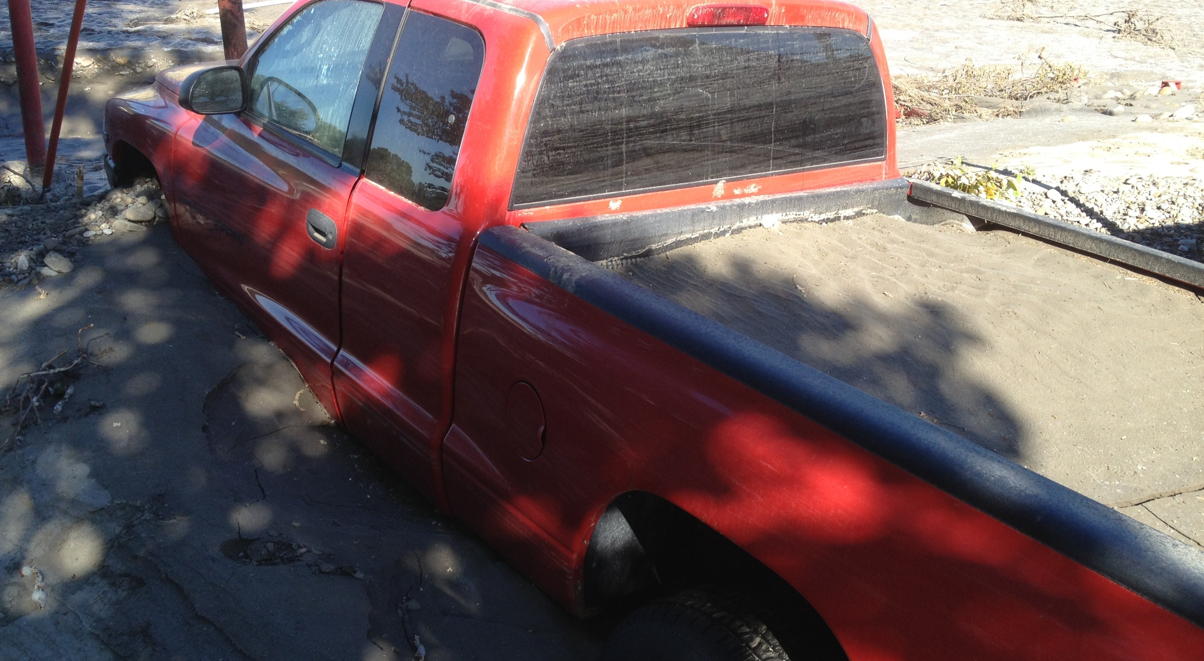
Alberta Flood
Notes:
Alberta, CUPE member’s photo
This photo was taken by a CUPE member who was called in from one municipality to another to help clean up a community in a part of Alberta that was flooded.

Slide 12
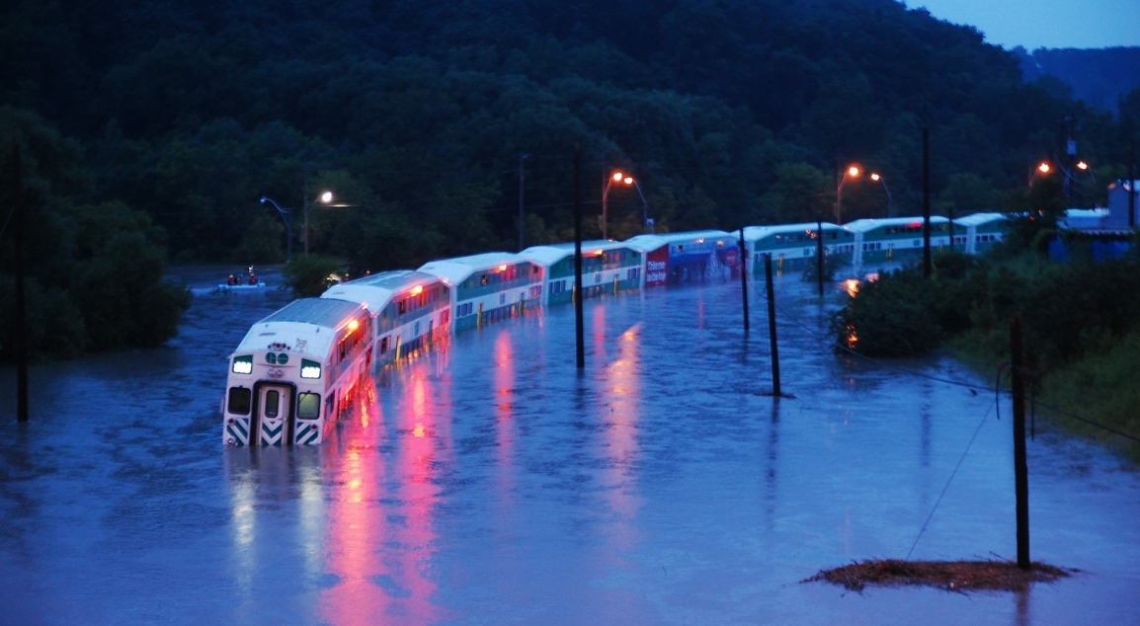
Toronto, July 8th 2013
Notes:
Toronto
The same year, in July 2013, Toronto was hit by severe rain and flooding. This event caused $850 million in damages and is Ontario’s most expensive disaster.
126 millimetres of rain fell in just a few hours, which is about a month’s worth of rain in one storm.
We hear this sort of statistic a lot recently: think of Buffalo, New York where a season’s worth of snow fell in just a couple of days in November 2014.

Slide 13
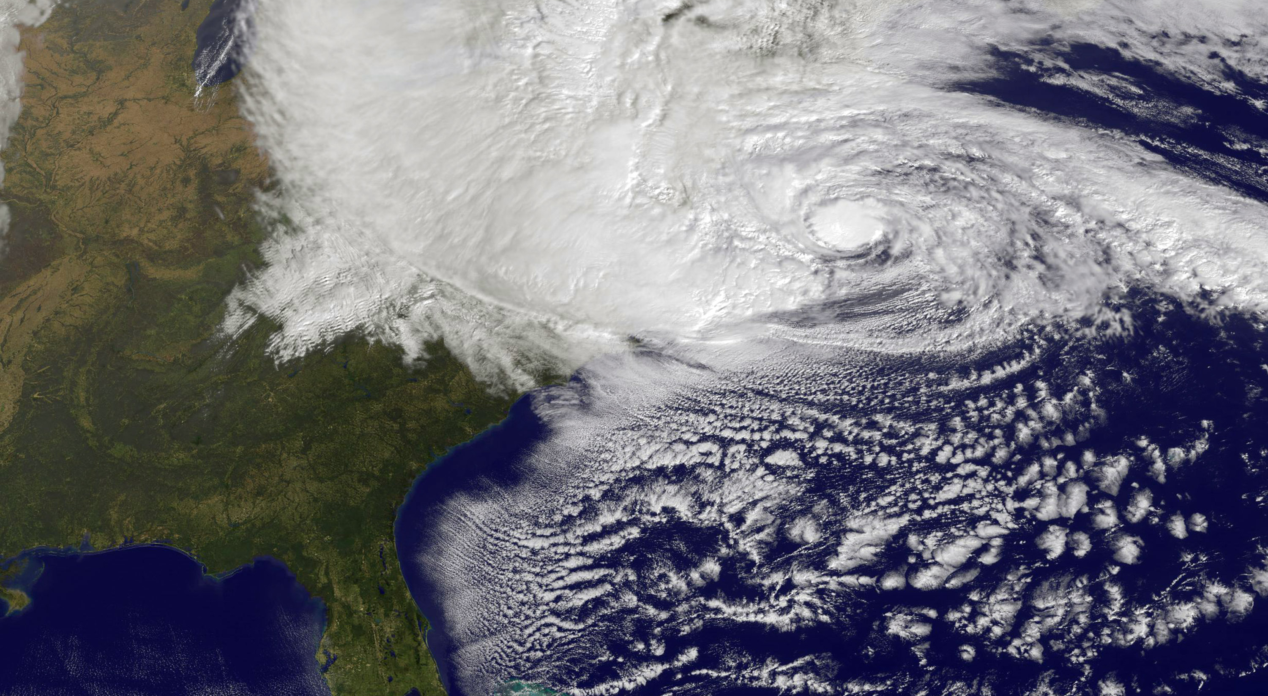
Massive storms
Hurricane Sandy, October 2012
Notes:
Massive storms
Here’s a visual that shows how massive hurricane Sandy was in October 2012.
The storm reached halfway across the Atlantic, up into Quebec and Ontario and into the US Midwest. And you can see the centre of the storm as it hones in on the eastern seaboard of the US.
Sandy was not the most powerful storm to ever hit the US, not by a long-shot. But it was big news because of how big it was and how it struck a densely populated part of the US.
Sandy caused the deaths of 268 people in seven countries as it crossed the Caribbean and then up to the States.
It caused $68 billion in damages, the second-costliest storm in US history.

Slide 14
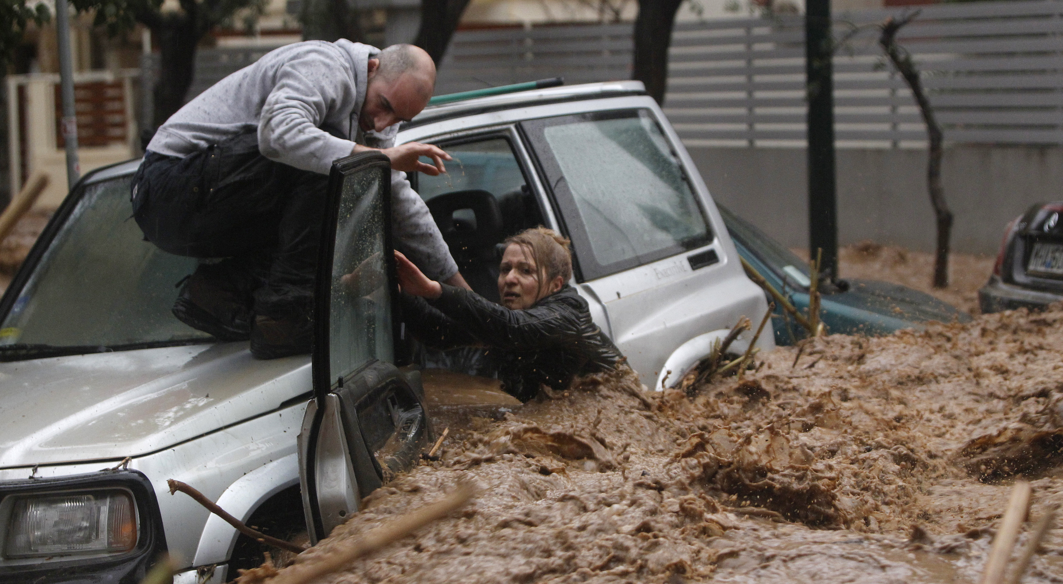
Flash floods
Athens, Greece, February 2013
Notes:
Floods
More floods.
This is also what climate change looks like. This is in Greece, in 2013.

Slide 15
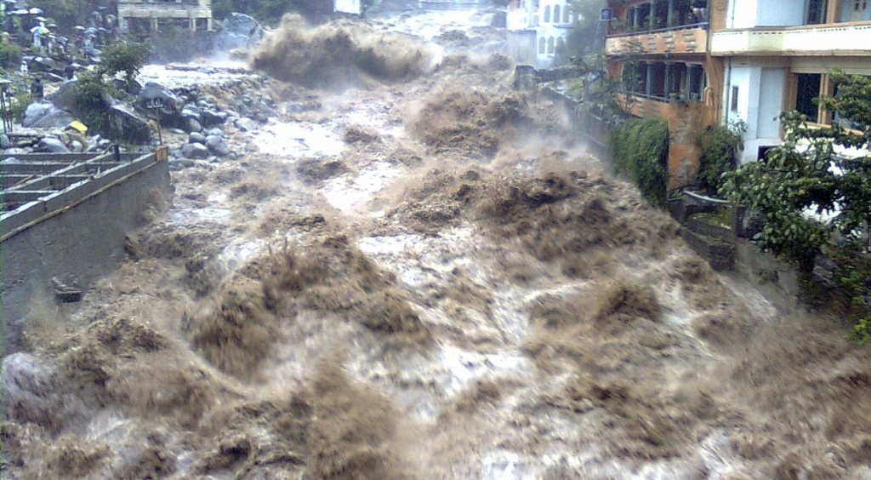
Flash floods
Pakistan, August 2012
Notes:
Floods
This is another massive flood, this time in Pakistan, in 2012.

Slide 16
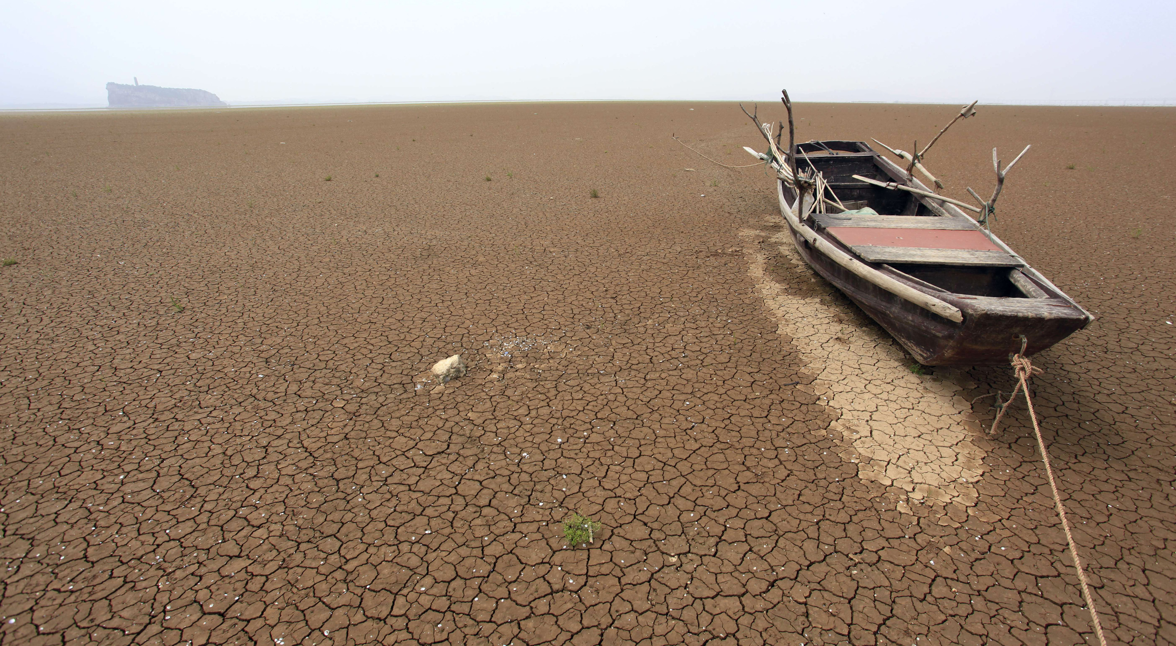
Drought
Poyang Lake, China, May 2011
Notes:
Drought
At the other end of the spectrum, climate change makes droughts worse.

Slide 17
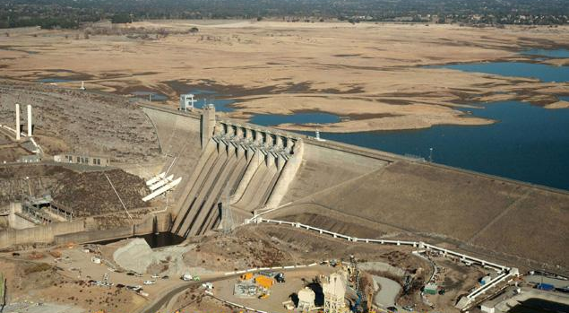
Drought & water supply
Folsom Lake, California, 2014
Notes:
Drought
Climate change affects water supply.

Slide 18
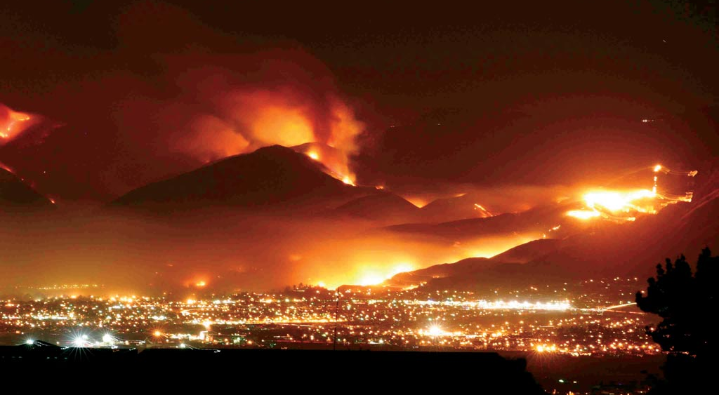
Wild fires
California, September 2012
Notes:
Wild fires
Wild fires are made worse by climate change.

Slide 19
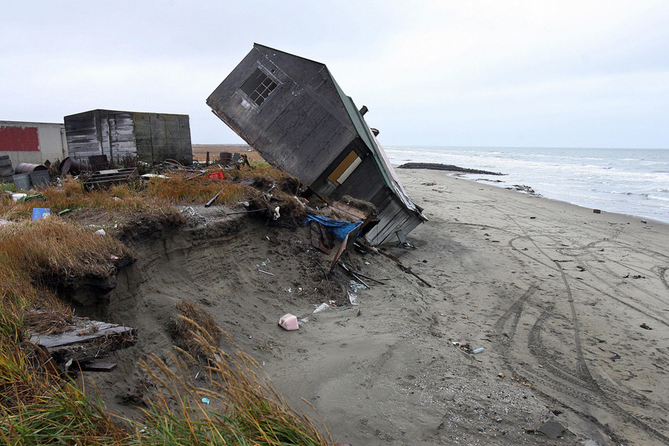
Melting permafrost
Shishmaref, Alaska, 2014
Notes:
Melting permafrost
Melting permafrost is made worse by climate change. It can devastate northern communities.
(Transition – say the points below if you want to add more detail to the previous slides):
Since 1992, there have been 6600 major climate, weather and water disasters worldwide that have caused $1.6 trillion in damages and killed about 600,000 people.
Between 1983 and 1992 the world averaged 147 of these disasters per year. That rate has jumped to an average of 306 disasters per year in the last ten years.
Not all of these disasters are caused by climate change. Poverty and socio-economic conditions, urbanization and other factors also contribute to these disasters.
But there is definitely a growing trend of more disasters and growing extremes that fits with what scientists have been saying for decades will occur as climate change gets worse.

Slide 20


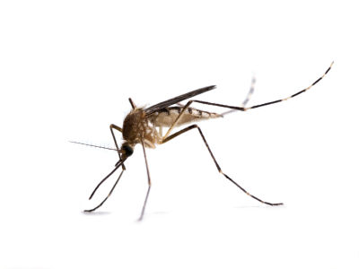
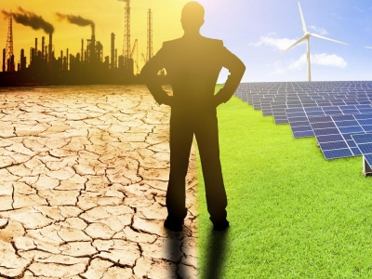
Systems vulnerable to climate
Water Food Health Jobs
Notes:
Global systems
Climate change does more than cause floods, droughts, etc.
It also affects agriculture, water supply, global health and our jobs.
All of these impacts can have serious effects on people, especially vulnerable people.

Slide 21
Discussion question:
What effects linked to climate change have you experienced or seen where you live and work?
Notes:
Discussion question
Now, we want to hear from you.
What effects linked to climate change have you experienced or seen where you live and work?
(Take the time needed to discuss this question.)

Slide 22
Climate change: The proof
We have seen the impacts. Climate change is happening now and is getting worse.
Let’s look at the science of climate change.
Notes:
What is climate change?
We’re going to go over the very basics of climate change science in the next few slides.
We’ve seen what it looks like and what the impacts can be, so we’ll talk next a little about the science of climate change.

Slide 23
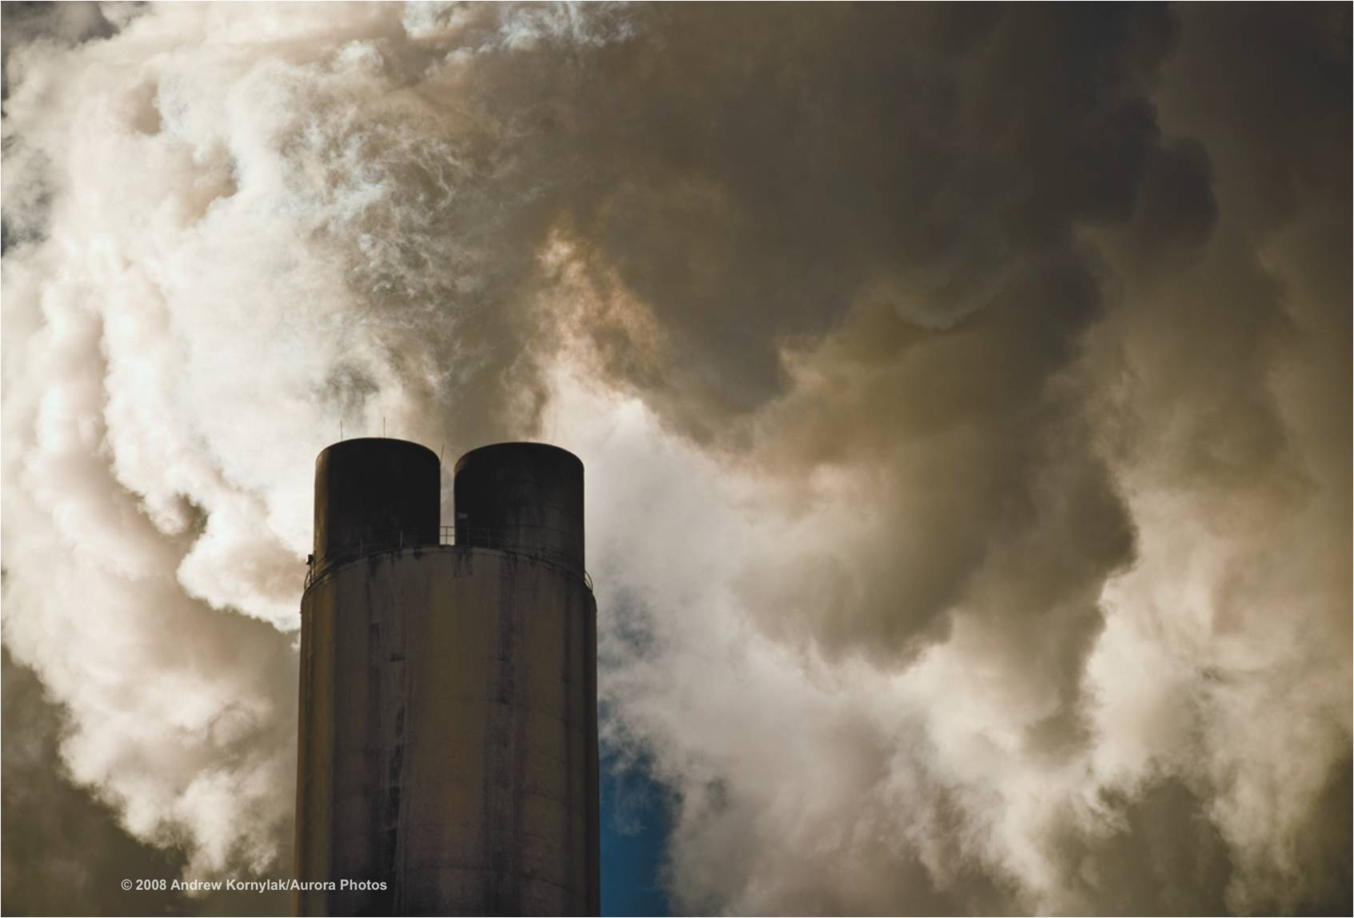
Burning fossil fuels releases greenhouse gases (GHGs) into the atmosphere.
GHGs build up over time and disrupt the chemistry of the atmosphere.
Notes:
Burning fossil fuels
The basic idea behind climate change is really simple: when we burn fossil fuels, what we call greenhouse gases are sent into the air. Those gases get trapped in the atmosphere and build up. When they build up – like they have been doing at a quickening pace for a couple of hundred years – they start to disrupt the climate because more heat energy is trapped inside the atmosphere.
We call them greenhouse gases, because, like heat in a greenhouse, the gases are trapped, like under a glass but in this case it’s the atmosphere, making the place under the glass (earth) warmer.

Slide 24
What are the main types of GHGs?
Carbon Dioxide (CO2)
Methane
Water vapour
Notes:
What are the main types of GHGs?
What are the main types of GHGs?
Greenhouse gases result mainly from burning oil, coal, and gas.
The main greenhouse gases that are emitted are carbon dioxide, methane, and even water vapour. These all work to store heat energy inside the atmosphere that would otherwise be dispersed and sent into space beyond the atmosphere.

Slide 25
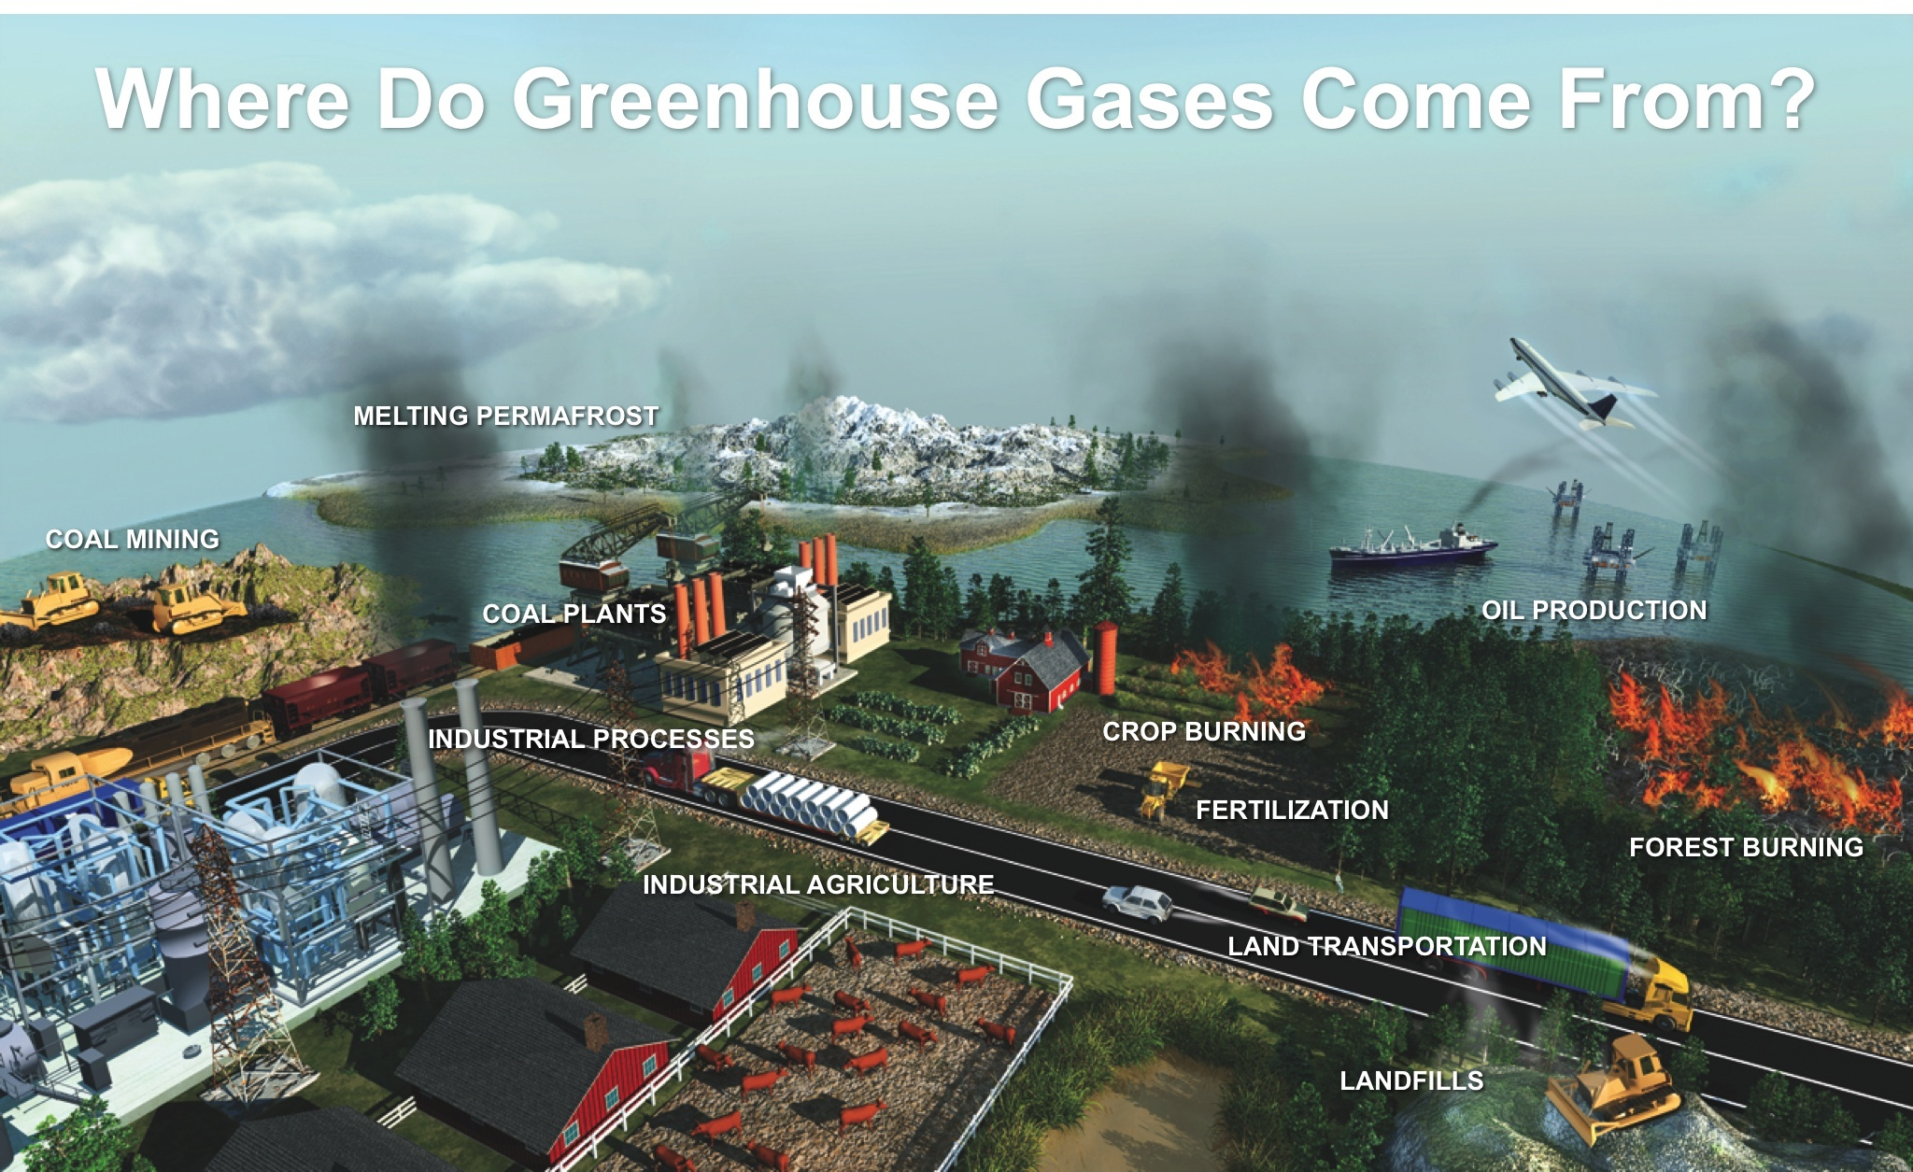
Where do greenhouse gases come from?
Notes:
Where do greenhouse gasses come from?
Where do greenhouse gasses come from?
This slide shows some of the main sources of GHGs.
(Go over the categories within the slide).

Slide 26
Some stats & impacts:
The average rate of global climate, water and weather disasters has more than doubled over the past ten years to 306 disasters per year.
These disasters cost, on average, $131 billion per year.
From 1992-2011, Greenland lost 3.35 trillion tonnes of ice.
39.8 billion tonnes of CO2 were emitted in 2013, versus 24.9 billion tonnes in 1992.
Notes:
Stats and impacts
Let’s look at a few of the impacts that show what is going on.
(Read the list of stats.)

Slide 27
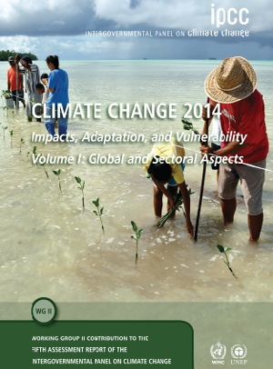
The science of climate change
The IPCC (Inter-Governmental Panel on Climate Change) brings the science on climate change together.
Its work is the largest scientific collaboration in human history.
Notes:
The science of climate change
The United Nations has a governing body called the Inter-governmental panel on Climate Change, the IPCC.
Just to give you a sense of how well studied climate change is and what goes into a climate change report from the IPCC – it is the largest scientific collaboration in human history.
So when you hear folks grumble that scientists don’t know what they’re talking about, remember the huge depth to which climate science goes to assess what’s going on.

Slide 28
IPCC conclusions:
Humans are the dominant cause of Global Warming.
GHG emissions must be cut.
Notes:
IPCC conclusions
The IPCC has concluded with 95% certainty that humans are causing climate change.
The IPCC has recommended that we need to cut emissions.

Slide 29
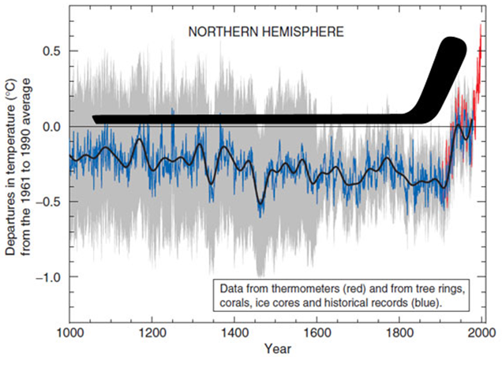
Historic Fossil Fuel Emissions
(the “hockey stick” graph)
Notes:
Emissions graph (hockey stick)
Here is a quick visual for you to consider.
It shows how quickly temperatures have recently risen. Temperatures were pretty steady, until recently when GHGs also started to rise.

Slide 30
This is what you call a warming trend:
2015 was the 39th consecutive year with a global temperature above the 20th century average.
We are heading to 2 degrees or more of warming across the planet.
Notes:
Warming trend
The trend is indisputable.
We have experienced 39 years in a row where globally the temperature was above normal. We haven’t had a truly “cold” global year since the mid-1970s.
Imagine watching a weather report that showed 39 years of above average temperatures. That’s basically what’s happened when you measure climate change across the planet.
We have warmed up the planet about one degree so far and are on a path to warm it up by 2 degrees.

Slide 31
Discussion question:
If these trends continue, what do you think the impacts will be in the next 25 or 50 years?
Notes:
Discussion question
Ask the question and take the time to discuss ideas.

Slide 32
There are solutions!
  Activism and political pressure.
  Workplace environmentalism.
  Legislation and regulation.
  Climate jobs and greening the economy.
Notes:
There are solutions!
When we talk about solving the climate crisis, we have to remember that workers have a lot to contribute to this issue.

Slide 33
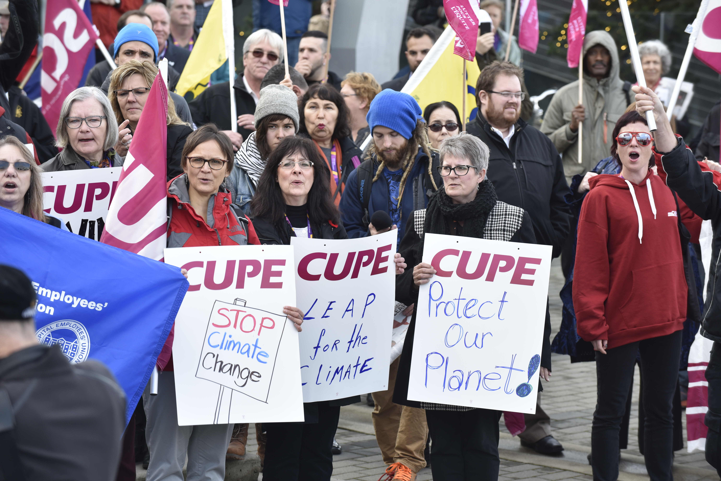
Activism: CUPE climate rally, November 2015
Notes:
Activism
Part of the solution resides in our own activism.
CUPE members do support action on climate change; and we need to intensify our actions.

Slide 34
Green workplace actions:
  Environmental committees.
  Workplace green audits.
  Green bargaining.
  Member to member conversations.
Notes:
Green workplace actions
CUPE members can make changes at work, such as taking these actions.
(Read possible actions from the slides).
CUPE national has produced many tools that can help. There is an online tool to do an eco-audit of your workplace. There is also a fact sheet that shows how to set up a workplace environment committee. CUPE also has a national environment policy.

Slide 35

Legislation and regulation
Municipal
Provincial
Federal
International agreements
Notes:
Legislation and regulation
We also need legislation and regulation at every level of government to cut greenhouse gas emissions.
International treaties – such as the United Nations negotiations on climate change – are also vital for international co-operation and action on climate change. But they are not enough.

Slide 36

Climate jobs and greening the economy
Renewable energy.
Public transportation.
Green buildings.
Just transition.
Notes:
Climate jobs and greening the economy
Taking action on climate change can help change our economy and make our work better for the planet.
While new types of work are needed, we also have to make sure workers and communities are treated fairly and given retraining opportunities as jobs change – this is what we mean by Just Transition.
CUPE is active in the Green Economy Network, that brings unions and environmentalists around the same table, to promote solutions.

Slide 37
Discussion questions:
What are your ideas for dealing with climate change?
How can we talk with other CUPE members about climate change?
Will you have a CUPE climate change conversation or two where you work?
Notes:
Discussion questions
And now, we want to hear your ideas, your solutions.
(Read the questions on the slide).
(Have an open discussion based on these questions and take the time needed to hear lots of ideas in the room.)

Slide 38
CUPE and the climate
  Want to talk more?
    There are other resources here:
  The CUPE National Environment Committee.
  Your division CUPE environment committee.
  National office (mfirth@cupe.ca).
Notes:
CUPE and the climate
If you want more information, you can get more information here.
Thank you.
:md/cope 491

