Slide 1

Taxation, the Public Sector and the CFIB
Presentation for
CUPE Western Canadian
Municipal Workers’ Conference
Regina, Saskatchewan
11 June 2010
Toby Sanger, Senior Economist, CUPE National
Notes:
Economics has a reputation as the “dismal science”. I have to defend my profession and say It’ really not true.
That’s because It’s not really a science. Otherwise, why would so many mainstream economists have completely failed to predict the recent financial crisis and ensuing recession?
As far as being dismal, well that’s kind of deserved.
Economists a bit like doctors: get excited by problems. Don’t you find it disturbing when you go to the doctor and they say “that’s a really interesting illness you have”
Thanks a lot! I’d be fascinated too, if I wasn’t going to die!
Last couple of years have been sort of fascinating for economists.
A year and a half year ago, strong chance we could have gone into a deep economic recession. Harper denied there was any sort of recession, fought like a dog to stay in power.
After condemning deficit spending for decades, MSE and world leaders realized we’d be in the toilet for years unless goverments put in place massive stimulus programs, including low interest rates but also large amounts of fiscal stimulus –which used to be known as “deficit” spending”.
The good news is that it has worked.

Slide 2
Stimulus has worked so far: strong recovery
Notes:
Stimulus spending has really worked.
Used to call it deficit spending when a government spent more than it took in, but that became such a bad word, that they had to give it another name when they wanted to use it, so they rebranded it “stimulus”.
It’s the same thing – and it works when the private sector economy goes into the dumps. We’re having a strong recovery with a rebounding of economic growth (blue lines) slower job growth and a gradual decline in unemployment rates (red lines).
Certainly haven’t regained all what we lost in the recession and many regions and sectors of the economy are still in bad shape, but the good news is that things are getting better – thanks to strong stimulus.

Slide 3
Ontario and West hardest hit by job loss
Notes:
Ontario and Western Canada have been worst hit by this recession.
The green columns show what the unemployment rate was when the recession started; the red columns where it is now.
Unemployment in some Atlantic provinces even lower now than it was in October 2008; but the jobless situation still considerably worse in Ontario, Alberta and BC.

Slide 4
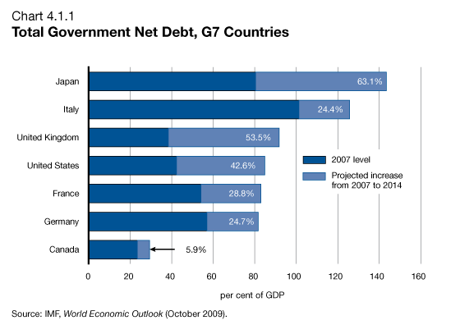
Canada’s debt situation good, will get better
Source: Federal 2010 Budget, page 154
Notes:
Another bit of good news is that Canada is in the best fiscal shape of all the major industrialized countries, what are known as the G7 countries.
This chart shows where we are now in terms of our government’s total debt and how much it is expected to grow.
Because our economy is growing stronger than expected, even this forecast is too high.
Just a couple weeks ago, the federal government revealed that the deficit for last year came in $7 billion less than they had just forecast thanks mostly to stronger revenue growth because of the the growing economy and increase in employment.
And deficits for the next few years are also expected to be $5 to $10 billion less than they forecast in the recent federal budget.
There’s really very little reason for us to be cutting back on government spending now and if we do so, it could endanger the recovery.

Slide 5
Economic growth being driven by government and households
Notes:
As you can see, our economic recovery is being driven entirely by increased spending and investment by governments and by households: that’s you and me spending our hard-earned dollars.
Meanwhile businesses, have frankly, been a drag on growth. As you can see, private business investment was lower in the first quarter of this year than it was in the depths of the recession a year before.
That’s a real concern.
If governments and households cut back spending, or if there is a bust of the real estate bubble, we could very easily have a double-dip recession, because business hasn’t been stepping up to the plate.

Slide 6
Corporate profits up but investment down
Notes:
It’s not because of a lack of profits, or a lack of tax breaks.
As you can see, corporate profits have increased by more than 15%, yet their investment in the economy has declined by more than 10%.
This is after business have been given tax break after tax break by our federal and provincial governments.
Even people like the governor of the bank of canada are getting increasing exasperated. In recent speeches, he’s basically said: we’ve given you everything: low taxes, low interest rates, lots of credit: syou’re really going to have to do your part.
The sad truth is this policy of cutting taxes for business to promote growth hasn’t worked. It hasn’t worked in the past decade and I don’t see how it is going to work now.

Slide 7
Canada’s corporate tax rates slashed
Notes:
Canada has slashed its corporate tax rates over the past decade. They are much lower than the United States now and our governments are cutting them even further.
On top of that, other tax changes such as the shift to the HST in BC and Ontario will involve a massive tax shift from business to consumers.
Problem in particular with cuts to the corporate income tax is that it only helps profitable companies. The cuts to the CIT over the past ten years have allowed the big six banks to pay approximately $20 billion less in taxes over the past decade.
Those who are struggling get no benefit from it. It also doesn’t directly help stimulate investment.
What would work a lot better than CIT cuts would be investment tax credits

Slide 8
Notes:
This has led to a stunning growth in corporate profits in Canada over the past twenty years. We were told that this would benefit all of us through trickle down growth.
Well, it hasn’t happened much. We had growth in jobs, but very little growth in real wages. The average industrial hourly wage now isn’t much higher than it was twenty years ago.

Slide 9

Corporate profits take record share but not investing in economy
Notes:
What’s also really disturbing is that while the rate of profit has been going up, the share that corporations invest in our economy has been going down.
And it’s led to an actual decline in in our economic “productivity”. That means that we are working harder as a nation to produce the same value of goods.
It’s not often that this has happened for such a long period in our economic history, but it happened in the last decade right after our governments started on their tax cut crusade – and that was even before the recession struck.

Slide 10
Record household deficits—and corporate surpluses—developed
Notes:
One consequence of this trickle down low wage policy was that corporations amassed record profits and surpluses during the past decade, while households went increasingly into debt as a result of low wage growth and the escalating cost of housing.
The real debt problem that exists now isn’t with governments, but it is with households, who have suffered from low wage growth and an escalating cost of living and housing.

Slide 11
Growing inequality, spoils to the richest
Notes:
Over the last couple of decades, we’ve also experienced an almost unprecedented increase in inequality in the United States and in Canada.
Because of these high corporate profits and cuts to high income tax rates, levels of income inequality are back to where they were in the 1920s and 1930s.
It should have really been no surprise that the same conditions of an increasingly unbalanced and unequal economy that led to the great depression also led to the worst global economic downturn since the 1930s.

Slide 12
Economic crisis caused by finance, not workers
“I made a mistake…I found a flaw in the model…that defines how the world works.”
Alan Greenspan, former head of U.S. Federal Reserve 23 October 2008
“We are facing a systemic failure. This global crisis …was created by a toxic combination of unethical behavior by companies and a faulty regulation and supervision of their activities.”
OECD Secretary General Angel Gurría, 22 January 2009
Financial crisis was caused by “people over-leveraging” and ``over- deregulation''
Stephen Harper, Bloomberg News 28 September 2008
Notes:
Last year, even some of those who were most to blame for these economic policies admitted that they’d been wrong.
Now of course Stephen Harper couldn’t bring himself to admit that his policies of deregulation were wrong, but he almost did, by saying that it was caused by “over-deregulation”.
In the past, they’ve blamed workers wages for the problems of the economy. This time they admitted that it was caused by an out of control finance sector and the economic policies they’d put in place.

Slide 13
Cuts to wages won’t help
“The recipe has to be trickle-up economics…cuts in the corporate tax rate can’t help much...”
  Avery Shenfeld, CIBC economist, 23 January 2009
“Cuts in hourly wages and salaries (and).. salary freezes (can lead to a) wage price deflationary spiral (that) is very difficult to stop…”
  Sherry Cooper, BMO chief economist 23 January 2009
Notes:
Even mainstream bank economists warned governments that more cuts to corporate taxes wouldn’t do much and cuts to wages and salaries could be dangerous.

Slide 14
Federal and provincial budgets
With:
Households spending but at record debt levels…
Corporations with record surpluses, but not investing…
They:
Freeze public sector salaries
Increase sales taxes (HST)
Cut corporate and business taxes even further
No new stimulus
Plan to sell off public assets and privatize
Notes:
While governments did the right thing in their budgets last year, they’re doing the wrong thing this year. Not all, but many governments have taken steps to effectively or indirectly freeze the wages of public sector workers, increase the tax burden on households while cutting business taxes even further.

Slide 15
Wage squeeze for federal and provincial workers across Canada
Federal: Legislated wage increases, freeze departmental spending.
BC: Two year freeze bargaining mandate; net zero increase in overall wages.
Manitoba: Two year wage freeze public employees.
Ontario: Two year wage freeze.
Quebec: Offering 7% over five-years.
NB Policy for two-year wage freeze.
Notes:
Fortunately, most workers in the municipal sector haven’t been hit with wage freezes or cuts, but there has been increasing pressure, sometimes directly from Premiers, on municipalities to freeze their wages.

Slide 16
Public sector wages only just recovered
Notes:
Unfortunately, this is history once again repeating itself.
After the last recession in the early 1990s, public sector workers suffered from years of declining real wages –with as the cost of living outpaced wage increases.
In many cases, we were able to achieve improvements in other areas, such as better benefits, pensions and improved job security, but general wage increases were subdued to say the least.
It was only in the past few years on average that public sector workers have regained the real wage losses from the 1990s.

Slide 17
CFIB attacking public sector—again
Notes:
Unfortunately, one of the main pieces of so-called “evidence” that the media and different governments have used in their attack on public sector wages was a highly misleading report published by the Canadian Federation of Independent Business called “Wage Watch” which purports to compare average public and private sector wages for different types of employers across Canada.
They’ve been doing this for years, but this time it got lots of media coverage during the municipal strikes last summer in Toronto and Windsor. This study claims to show that wages of public sector workers average 8-17% higher than private sector wages.
You and I know that this isn’t true. In many cases, your contracts have included trade adjustments just to retain workers from the private sector.
I—and others—have gone through the fine print of their study and found they manipulated and distorted the Census data in about ten different ways to get these results.
I won’t go into all the details of how they distorted the figures here—some of it is pretty complicated and technical—I’ve summarized some of it in a brief at the back
Compare the wages for skilled workers to the wages for retail clerks and cashiers
Excluding the salaries and incomes of many high paid occupations in the private sector.
No adjustment for skills, education, experience, etc
Misused averages
Quite suspicious because didn’t reveal any actual wages/ salaries by occupation; just the averages of their manipulated data.
Interesting that they said that senior managers in the public sector aren’t paid enough! Real objective for them is to drive down wages of lower paid workers in the public sector and elsewhere, while maintaining high levels of compensation at the top levels.

Slide 18
Reality is average wages are comparable wage “advantages” from pay equity, experience
Notes:
We decided to get exactly the same data that the CFIB used: detailed Census data from Statscan.
Took a long time to get it. Just received some of it a few days ago. Haven’t had time to properly analyze it yet. Even before adjusting for education, experience, etc., overall results show a very different picture from what the CFIB purportedly showed.
Total overall results for all occupations show averages wages and salaries between public and private sectors are very similar.
Including all age groups, all occupations and both men and women, overall average is within one or two percent.
The big differences for the public sector are for younger workers and for women. For older workers, aged 41 plus—which probably makes up most of the people in this room—and most of the PS workforce, average wages in the public sector are lower than in the private sector.
For women, the big difference is pay equity. Federal and provincial public sector employers quite rightly obliged to provide equal pay for work of equal value while many women in private sector continue to be underpaid.
Haven’t had time to examine in detail yet, but we know that public sector pays relatively more than private sector for traditionally lower paid occupations, while private sector pays much more at the top end: much greater equality of wages in public sector.
No apologies for this: this is what we’ve fought for as a union: greater equality, better wages and working conditions for all workers, but especially those at the lower end of the scale. Fighting for increases to minimum wages, living wages decent pensions for all.
Meanwhile in the private sector, inequality continues to grow: average top CEO in Canada takes home more in less than one day than minimum wage worker for a year’s work. That’s the world the CFIB wants us to emulate.
CFIB describes themselves as the voice of small business, but shouldn’t the millions of people who work for low wages and inadequate benefits in small business also have a voice?
We’ll be doing more detailed analysis on this issue in coming months and prepare accessible material that you can use on this.

Slide 19
Corporate taxes: further cuts and revenue losses paid, partly for, by public sector wage freezes
 | Federal | Federal | Ontario | Ontario
 | Rate | Loss (billions) | Rate | Loss (billions)
2009 | 19% |  | 14%
2010 | 18% | -$0.6 b | 12% | -$1 b
2011 | 16.5% | -$2.8 b | 11.5% | $-1.5 b
2012 | 15% | -$5.2 b | 11% | -$1.9 b
2013 | 15% | -$5.8 b | 10% | -$2.6 b
Meanwhile….
Department spending freeze to save Ottawa $1.8 billion a year
Notes:
Federal and provincial governments—the two jurisdictions with the highest deficits—are further cutting corporate tax rates at the same time as they are squeezing wages for public sector workers, and as they will be
- Federal CIT cuts to cost almost $6 billion a year. freeze in departmental spending to save a quarter of that.
- In Ontario, CIT cuts from this year to cost over $2 billion a year in lower revenues; public sector wage freeze to save a quarter of that.
Hypocritical for them to claim they’re doing this over concern for the deficit.
The issues of wage freezes and corporate tax cuts at the federal and provincial levels may not seem relevant for municipal workers, but they are very relevant.
As other public sector workers get their wages frozen—including many of your CUPE brothers and sisters-- pressure builds to to freeze your wages as well. The CIT rate in Alberta and BC is down to 10% already, but if Ontario goes ahead with corporate tax cuts, more pressure will build for Manitoba and Saskatchewan to further cut their rates.
As federal and provincial governments have less revenue coming in, they have less money to provide in transfers to municipal governments. This means more pressure on municipal budgets, less money for your wages and benefits, and less money to provide public services and/or more hikes to property taxes and user fees.
Coincidently enough, the shortfall in federal and provincial transfers to municipalities compared to what they were a decade ago is now about $5 billion.
We’re in this together: the struggle you have to maintain good public services and decent wages in your community are directly connected to the efforts to achieve fair taxes at the federal and provincial level.

Slide 20
Public spending strongest economic impact?
Source: Center for Spatial Economics, Informetrica, Federal 2010 Budget (p. 281)
Notes:
Cutting public services and freezing public sector wages also doesn’t make sense in terms of the economy.
This chart shows the economic stimulus impacts and jobs created from different types of public spending compared to tax cuts. These aren’t numbers I made up; they are taken from the federal budget and economic impact studies produced by independent economics firms.
The blue column are the jobs generated by public spending in different areas. As you can see, this is far higher for all types of public spending than it is for income tax cuts or corporate tax cuts, on the right side of the chart. The red dot shows how much a similar amount of spending would help grow our economy. This is also considerably higher for public spending than for tax cuts. Proponents of tax cuts claim that over the longer term, these tax cuts pay off, but as we’ve seen, there isn’t much evidence of that.
Multipliers Impact of $1 billion stimulus
Jobs GDP
Child care 40 $ 2.3
Health care & SS 18 $ 2.0
Infrastructure 16 $ 2.8
Education 12 $ 2.3
Income tax cut 6 $ 1.3
Corporate tax cut 3 $ 0.4

Slide 21
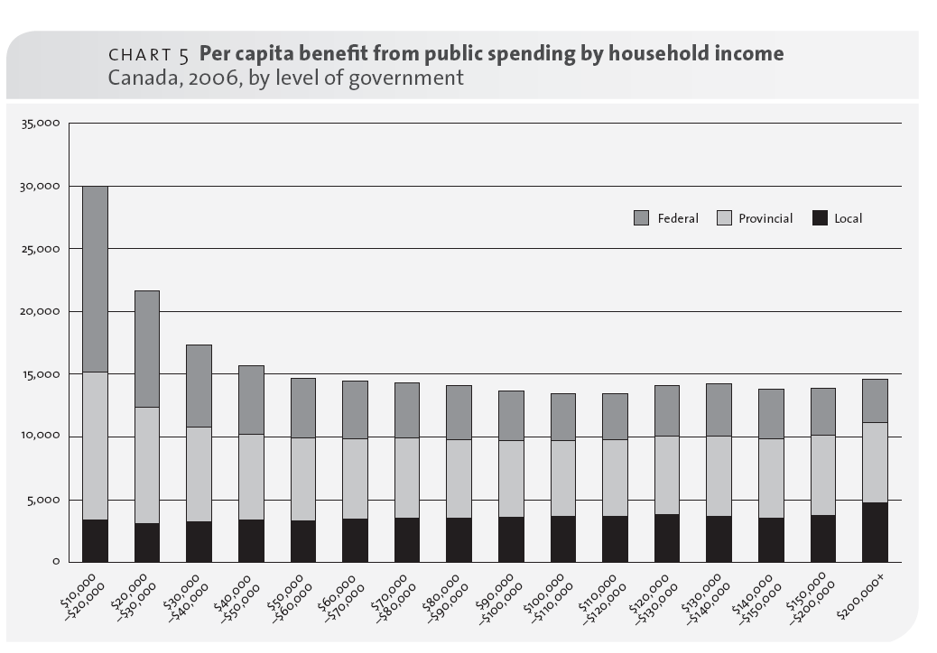
All Canadians, especially lower income, lose out from cuts to public spending
Canada’s Quiet Bargain, Canadian Centre for Policy Alternatives, 2009
Notes:
I want to wrap up with one final point.
People are always talking about the financial cost of public services and rarely about the benefits. We know about the important social benefits that your work provides to people and businesses in your community.
But the value of these benefits to people has rarely been calculated in dollar terms. Just last year, the Canadian Centre for Policy Alternatives published a groundbreaking study that did just that.
This study, entitled Canada’s Quiet Bargain, shows that Canadians of all income groups derive great benefits from the public services federal, provincial and municipal governments provide.
The value of public services added up to about $17,000 per person in 2006 and far more than that per household. This was worth about same amount as the minimum wage full-time, full year.
This study also showed that a large majority of Canadians would have been better off with increased public spending on health care, education and municipal government services than with recent cuts to income taxes or to the GST.
Some people have described the political and democratic process as like a form of collective bargaining that voters and taxpayers take part at least every few years to negotiate how much they are prepared to pay for public services and what they want to receive.
Poll after poll has shown that Canadians want more public services and are willing to pay more for them. But they also want the tax system to be fair. Because if the tax system isn’t fair and is regressive, then confidence in it is eroded and people avoid taxes and we end up in a situation like Greece where there’s a major shortfall of revenue and the government had to go abroad to fund their deficits.
The point here is that your collective bargaining doesn’t end at the negotiating table with your employer. It also must extend to the political process. Those with all the money and wealth are involved—and all of the rest of us need to be as well.

Slide 22
Thank you!
For more information:
CUPE Economic Climate for Bargaining, TableTalk
http://cupe.ca/economics
Progressive Economics Forum blog:
http://www.progressive-economics.ca/relentless/
mf/cope491

